Slide 1
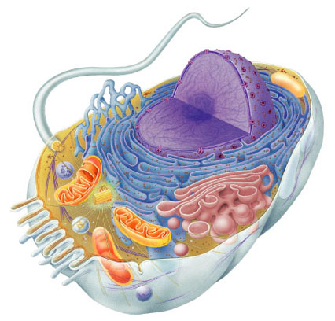
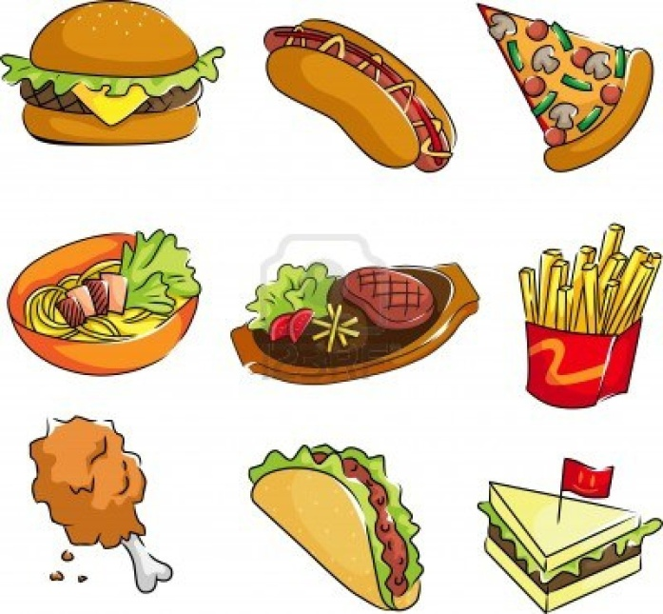
Cellular Respiration

Slide 2
Cellular Respiration?
What does cellular mean?
What does respiration mean?

Slide 3
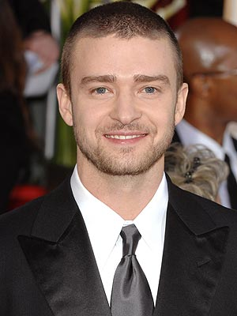
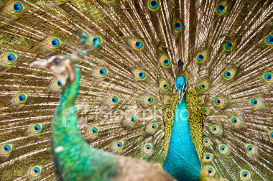
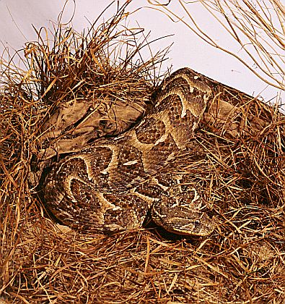
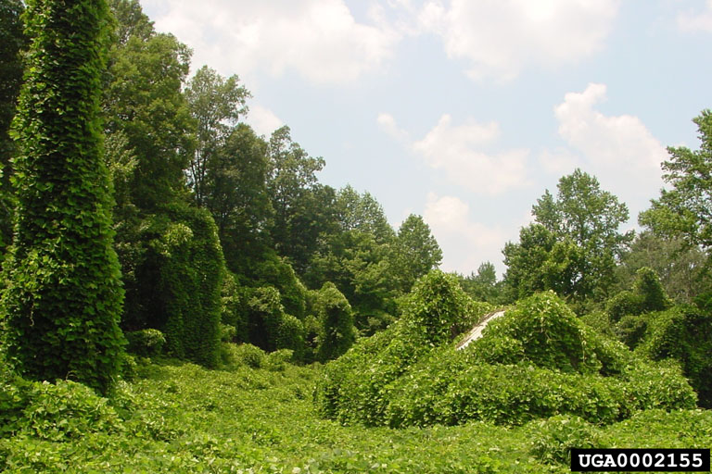
What organisms go through respiration?
All eukaryotes (animals, plants, fungi, and protista)

Slide 4
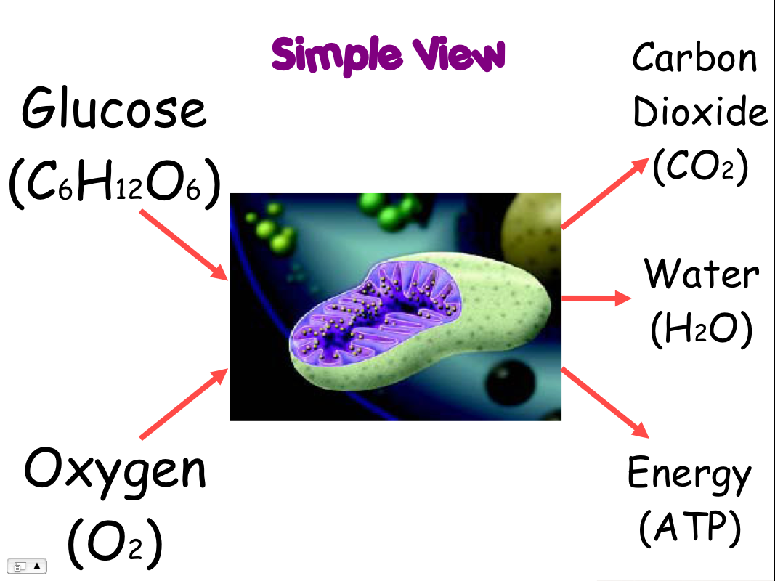
Cellular Respiration:
A process that makes ATP by breaking down carbon-based (carbohydrates/ sugars) when oxygen is present.
Intro to Cellular Respiration

Slide 5
Cellular Respiration
Cellular respiration is the process that converts oxygen and sugar (glucose) into water, carbon dioxide, and energy (ATP).

Slide 6
Respiration Eqn:
6O₂ + C₆H₁₂O₆ → 6CO₂ + 6H₂O + Energy (ATP)
oxygen
sugar (glucose)
carbon dioxide
water
energy
Reactants
Products

Slide 7
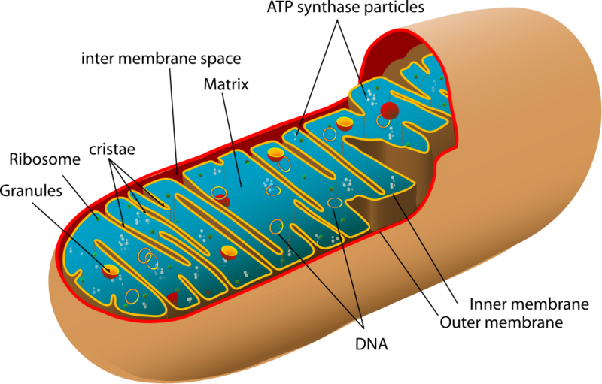
The Mitochondrion: “powerhouse”
Location of cellular respiration
Many exists within a cell
Was once believed to be a bacteria that was engulfed by another-endosymbiosis
ATP is made directly from chemical reactions (breaking down food)

Slide 8
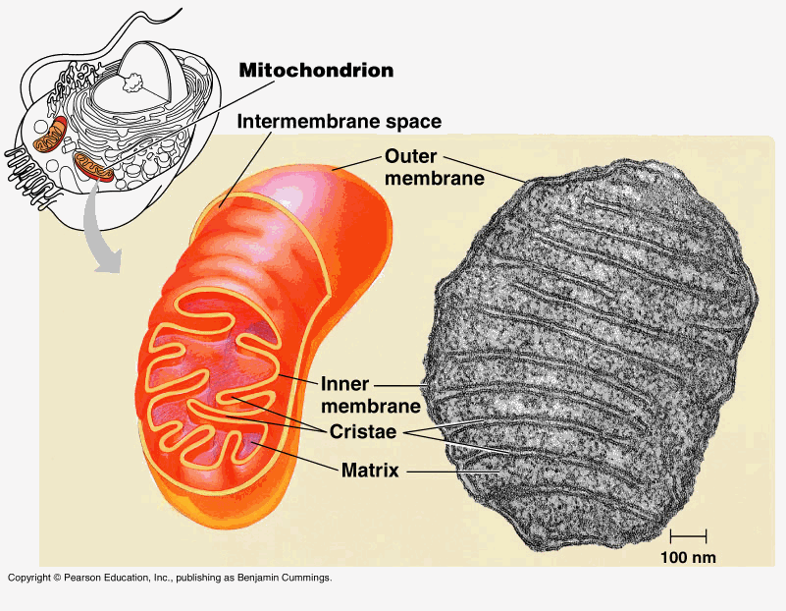

Slide 9
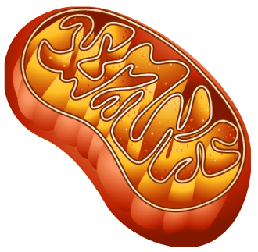
Structure of mitochondrion
Matrix (fluid inside inner membrane)
outer membrane
Intermembrane space
inner membrane

Slide 10
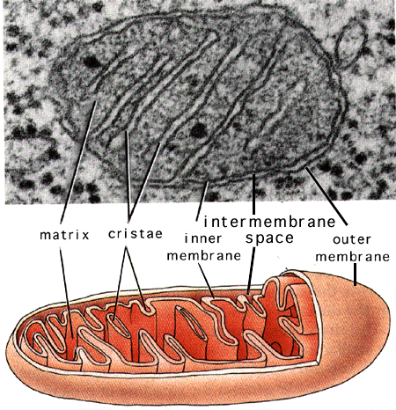

Slide 11
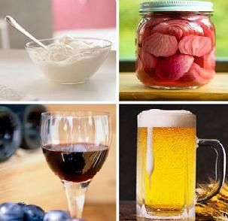
Cellular Respiration and Fermentation
Fermentation: an anaerobic process that allows glycolysis to continue.
does not make ATP but allows glycolysis to continue by providing a supply of NAD⁺
Anaerobic- does not require oxygen
Aerobic-requires oxygen
Lactic acid- fermentation in muscle cells (muscle burn)
Produces foods like cheese, yogurt, bread, wine)

Slide 12
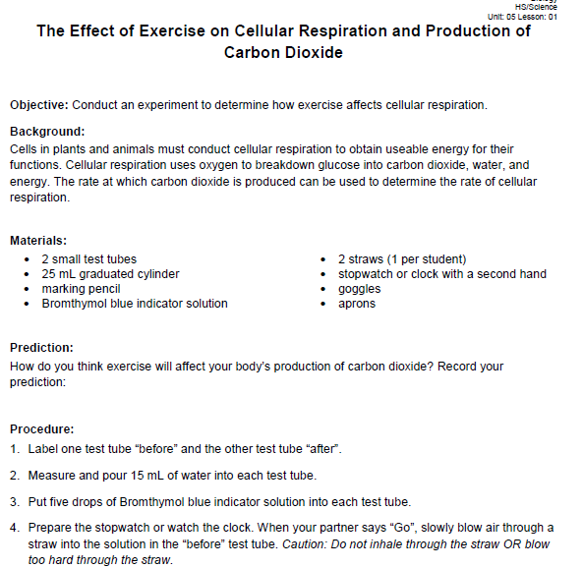
Demo: Effect of Exercise on Cellular Respiration

Slide 13
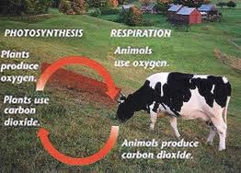

Slide 15
Animation of Cellular Respiration

Slide 16
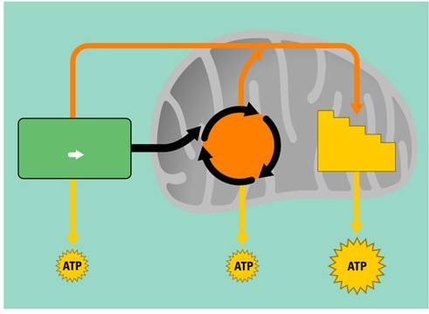
3 Stages:
1. Glycolysis
Cell’s cytoplasm
2. Kreb’s Cycle aka Citric Acid Cycle
Matrix of the mitochondria
3. Electron Transport
Inner membrane of mitochondria

Slide 17
Step 1: Glycolysis
Glyco = glucose (sugar)
Lysis = split or break up
Glucose is split in two

Slide 18
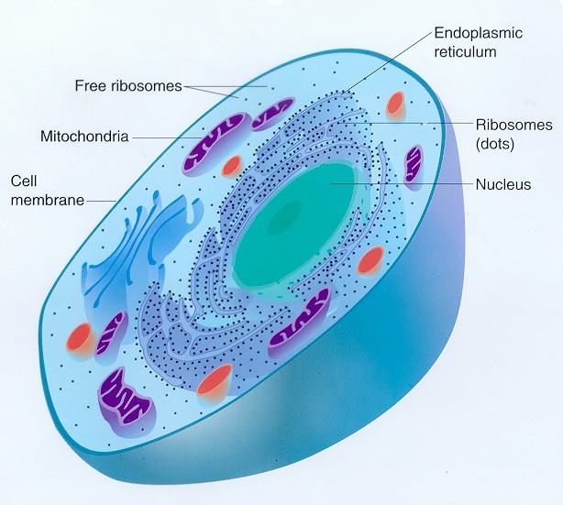
Glycolysis occurs in cytoplasm

Slide 19
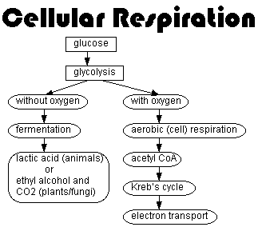
Glycolysis [Stage 1]
How Glycolysis Works

Slide 20
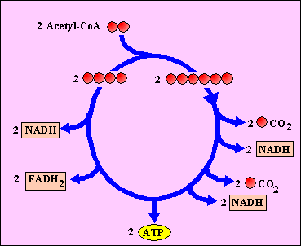
Krebs Cycle (Citric Acid Cycle) [Stage 2]
How the Krebs Cycle works
Krebs/Citric Acid Cycle lesson

Slide 21
Step 2: Kreb’s Cycle
+
+
Carbon dioxide
Makes CO2

Slide 22
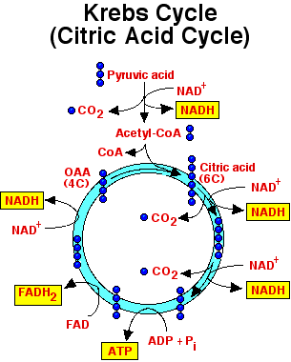

Slide 23
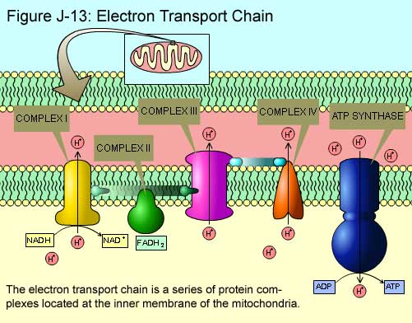
Electron Transport [Stage 3]
ATP Synthesis

Slide 24
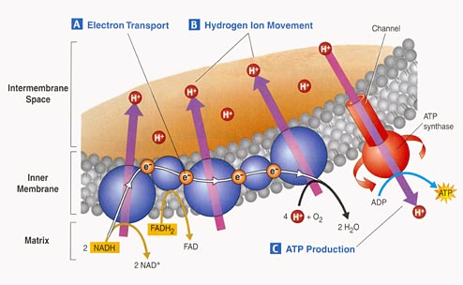
Step 3: Electron Transport Chain
e- force hydrogen ions to diffuse
Water is made
36 ATPs (energy) for 1 glucose molecule are made

Slide 25
Step 3: Electron Transport Chain (ETC)

Slide 26
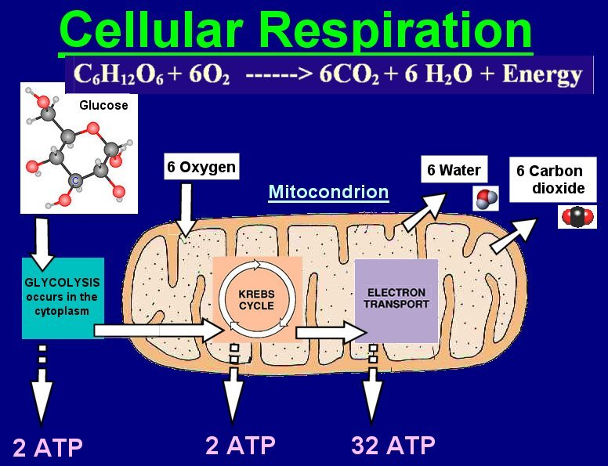

Slide 27
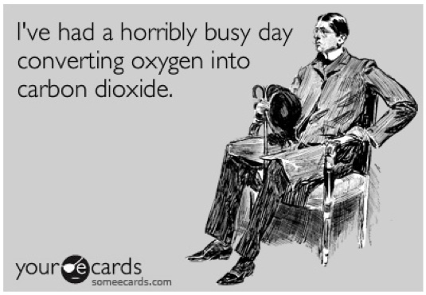
Let’s Wrap it Up- Cellular Respiration
story time

